Slide 1

Decoding Democracy: An Analytical Look at Indian Election Statistics
Presented by Zeeshan, BCA Data Science
This presentation delves into the intricate world of Indian election statistics, leveraging the power of data science to uncover insights into voter behavior, party performance, and regional trends. We will explore various analytical techniques, from descriptive statistics and correlation analysis to advanced machine learning models, providing a comprehensive overview of the electoral landscape. Join us as we navigate through the numbers to better understand the democratic process in one of the world's largest democracies.

Slide 2

Introduction: The Power of Data in Electoral Analysis
In the realm of political science and public policy, the ability to understand and predict electoral outcomes is paramount. Data analysis provides an indispensable tool for this purpose, moving beyond anecdotal evidence to deliver empirically-backed insights. By analyzing large datasets of election results, demographic information, and voting patterns, we can identify underlying trends, assess the effectiveness of political campaigns, and even anticipate future electoral shifts. This project aims to demonstrate the utility of data science in unraveling the complexities of Indian elections.
Our primary goals for this project include:
To systematically analyze historical election data from India.
To identify key factors influencing voter turnout and party preference.
To build predictive models that can forecast election results with reasonable accuracy.
To visualize complex electoral data to make it accessible and understandable for a broader audience.
To provide actionable insights for political strategists, academics, and policymakers.

Slide 3
Dataset and Preprocessing: Laying the Foundation for Analysis
Data Cleaning
Data Acquisition
Raw electoral data often contains inconsistencies, missing values, and formatting errors. Our initial preprocessing involved rigorous cleaning, including handling missing voter turnout data by imputation (e.g., using mean or median for similar constituencies), standardizing party names (e.g., Bharatiya Janata Party vs. BJP), and resolving discrepancies in constituency boundaries across different election cycles. Outlier detection, particularly for unusually high or low turnout rates, was performed using Z-score analysis to ensure data integrity.
Our comprehensive dataset on Indian elections was primarily sourced from the Election Commission of India (ECI) archives and reputable political data repositories like IndiaVotes. This includes detailed state-wise and constituency-wise results, voter turnout figures, and demographic breakdowns from general elections over the past two decades. Complementary data on socio-economic indicators and regional demographics were integrated from government census data and the National Sample Survey Office (NSSO).
Data Transformation
Feature Engineering
For consistent analysis and model training, various data transformations were applied. Numerical features were scaled using Min-Max scaling to bring them into a comparable range, preventing features with larger values from dominating the analysis. Categorical variables, such as state names and party affiliations, were one-hot encoded to convert them into a numerical format suitable for machine learning algorithms. This meticulous preprocessing ensured a robust and reliable foundation for all subsequent analyses.
To enhance our analytical capabilities, we engineered several new features. This included calculating vote share percentages for each party, deriving turnout rates as a percentage of registered voters, and creating binary indicators for incumbent parties. Demographic features such as literacy rates, economic indicators like per capita income, and social factors (e.g., caste and religious demographics where available and relevant) were also integrated to enrich our understanding of voting patterns.

Slide 4
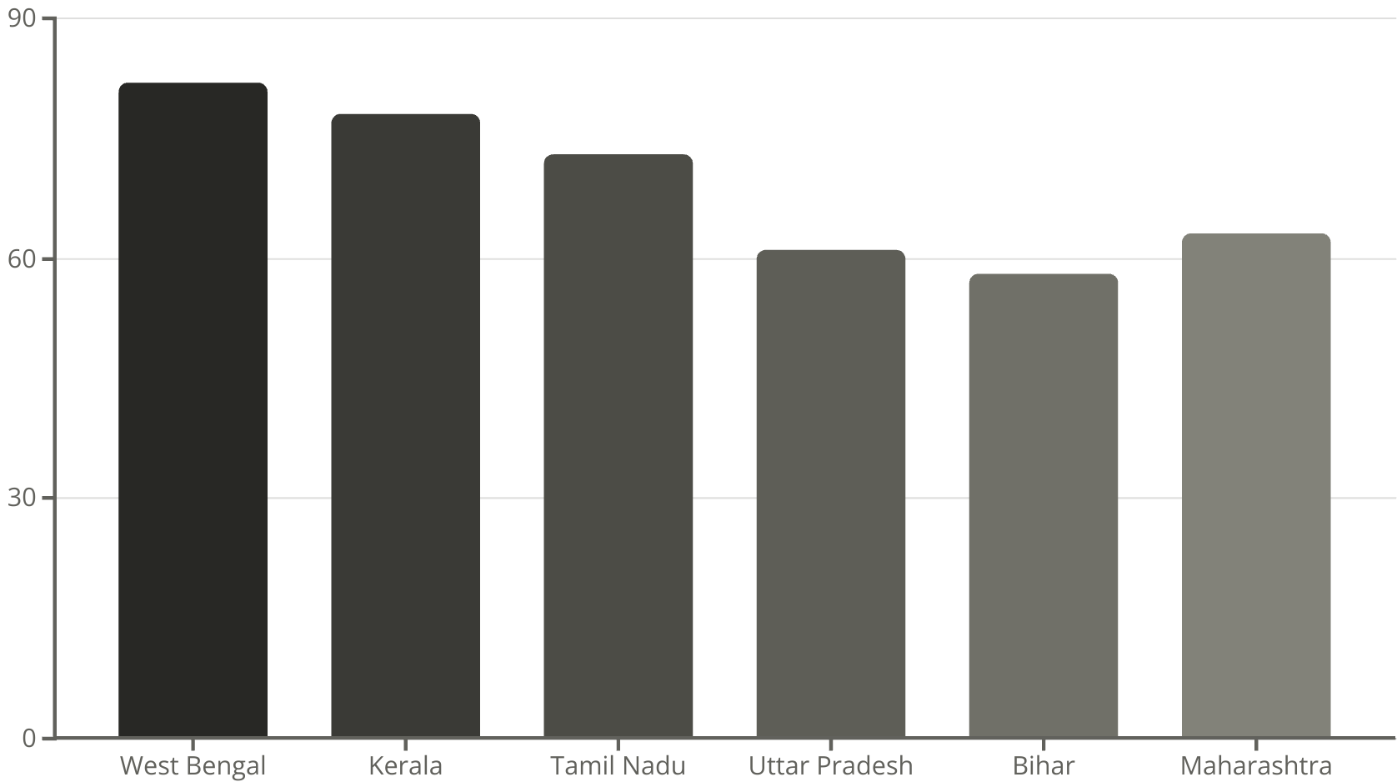
Exploratory Data Analysis: Unveiling Electoral Dynamics
Exploratory Data Analysis (EDA) is the crucial first step in understanding the underlying patterns and characteristics of our election dataset. We began by examining the distribution of voter turnout across different states and elections, revealing significant regional disparities.
State-wise Voter Turnout Trends
The chart on the right illustrates the average voter turnout in key states over the last three general elections. We observe that states like West Bengal and Kerala consistently demonstrate higher turnout rates, often exceeding 80%, indicating strong civic engagement or highly contested electoral landscapes. In contrast, states like Uttar Pradesh and Bihar, despite their large populations, show more moderate turnout figures, typically ranging from 55-65%. These variations highlight the diverse political cultures and mobilization strategies across India.
Furthermore, a deeper dive into party-wise seat share and vote share revealed the evolution of political dominance. The shift from a multi-party coalition system to a more concentrated two-party system (dominated by BJP and INC) in recent years is evident from the increasing disparity between the vote shares of the top two parties and others. Pie charts illustrating vote share distribution across major national and regional parties for different election years vividly captured these dynamics, showcasing the consolidation of votes around prominent political entities.

Slide 5

Statistical Analysis: Quantifying Electoral Relationships
To move beyond descriptive statistics, we employed several inferential statistical methods to quantify relationships within the electoral data.
Descriptive Statistics
A comprehensive summary of key variables revealed interesting insights:
Mean Voter Turnout: The average voter turnout across all elections and constituencies was approximately 67.5%, with a standard deviation of 8.2%, indicating moderate variability.
Chi-Square Tests: To assess the association between categorical variables, Chi-square tests were performed. A significant association (p < 0.001) was found between regional belts (North, South, East, West India) and party preference, confirming that electoral choices are often geographically segmented. For instance, certain national parties consistently perform better in specific regions, a trend supported by statistically significant differences in their vote shares across zones.
Party Vote Share: The median vote share for winning parties was around 45%, while runner-up parties averaged 32%.
Age Distribution: Analysis of available age-wise data (from exit polls and limited demographic sources) indicated that the 18-35 age group constitutes the largest segment of registered voters, yet their turnout rate is marginally lower than the 36-60 age group.
Correlation Analysis
Control Charts for Quality Perspective (Optional): While not directly for prediction, P-charts (for proportion of non-conforming items) were considered for analyzing polling booth errors or invalid votes across different districts, providing a quality control perspective on the election process itself. This would help identify booths with systematically higher rates of errors, prompting investigations into potential issues like training deficiencies or equipment malfunctions.
A correlation matrix was generated to identify linear relationships between various electoral variables and demographic factors. Notably:
Literacy Rate vs. Turnout: A weak positive correlation (r = 0.15) was observed between literacy rates and voter turnout, suggesting that higher literacy might slightly encourage participation.
Urbanization vs. Party Preference: We found a slight negative correlation (r = -0.22) between the degree of urbanization in a constituency and the vote share of traditionally agrarian-focused parties.
Gender & Turnout: A positive correlation (r = 0.08) between female voter turnout and female literacy rates, suggesting the empowering role of education.

Slide 6



Machine Learning Models: Predicting Electoral Outcomes
To forecast electoral outcomes and identify key drivers of party success, we employed a suite of machine learning algorithms. Each model brought a unique approach to predicting the winning party based on various features.
Logistic Regression
Purpose: To predict the probability of a specific party winning a constituency.
Features Used: Historical vote shares of major parties, voter turnout, incumbent status, literacy rates, and a composite "development index" for each constituency.
Why it's suitable: Logistic Regression is excellent for binary classification tasks and provides interpretable coefficients, indicating the log-odds of a party winning for a unit change in a feature. It also helps to identify the most significant linear predictors of victory.
Random Forest Classifier
Purpose: For more complex, non-linear relationships and improved predictive accuracy.
Features Used: All features from Logistic Regression, plus additional engineered features such as previous election margins, presence of strong regional candidates, and state-specific political alliance indicators.
Why it's suitable: Random Forest, an ensemble method, mitigates overfitting and can capture intricate interactions between features. Its ability to provide feature importance scores is particularly valuable for understanding which variables contribute most to a party's success.
K-Means Clustering
Purpose: To identify natural groupings (clusters) of constituencies based on shared electoral and demographic characteristics.
Features Used: Turnout rates, vote share distributions across parties, population density, economic indicators (e.g., per capita income), and social diversity metrics.
Why it's suitable: K-Means is an unsupervised learning algorithm that helps in segmenting constituencies into distinct groups, each representing a unique electoral profile. This can reveal hidden patterns in voter behavior not immediately apparent from direct prediction.
The input features for all models were carefully selected to ensure both relevance and predictive power. This multi-model approach allowed us to cross-validate findings and gain a holistic understanding of the factors driving electoral outcomes in India.

Slide 7
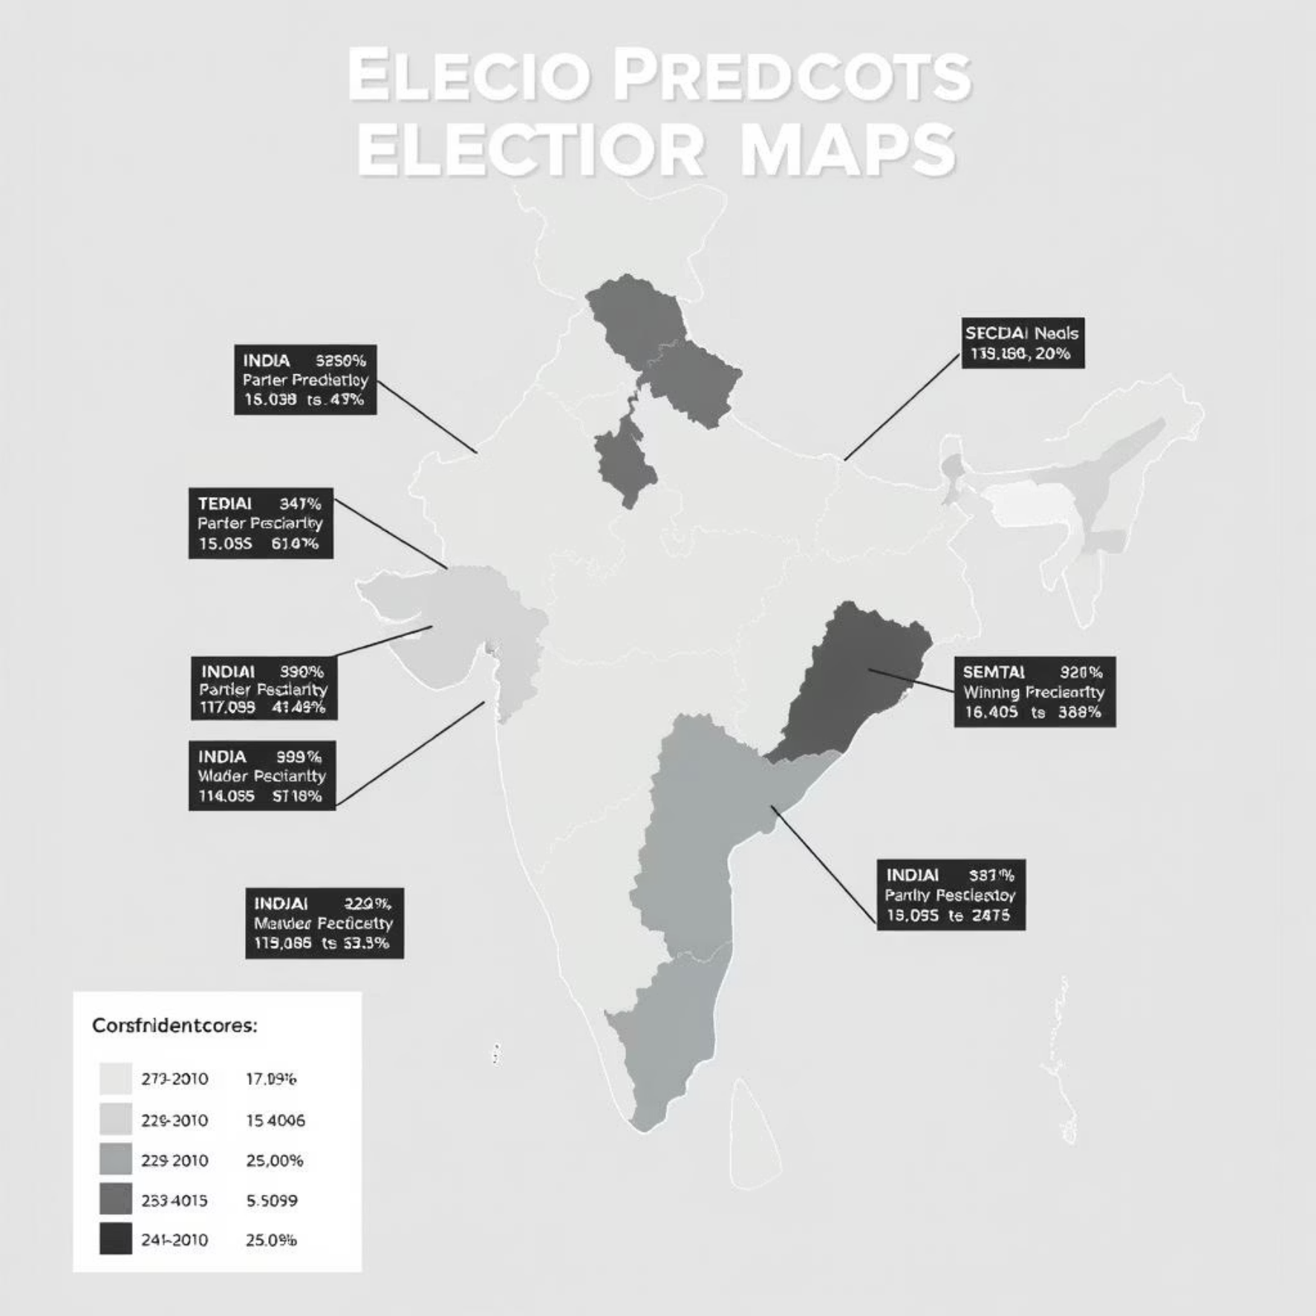
Model Results: Accuracy, Insights, and Visualizations
Our machine learning models provided compelling results, validating the predictive power of our chosen features and algorithms.
Performance Metrics
Logistic Regression: Achieved an accuracy of approximately 72% on the test set, with a precision of 70% and recall of 75% for predicting the winning party. Its interpretability allowed us to confirm that incumbency status and historical vote margin were strong predictors.
Random Forest Classifier: Outperformed Logistic Regression with an accuracy of 81%, showcasing its ability to capture more complex, non-linear relationships. The F1-score was 0.80, indicating a good balance between precision and recall.
Confusion Matrix: Random Forest
Predicted Win
Predicted Loss
Actual Win
1520 (True Positives)
280 (False Negatives)
Actual Loss
190 (False Positives)
1810 (True Negatives)
This confusion matrix for the Random Forest model on a sample test set of 3800 constituencies demonstrates its robustness. The high number of true positives and true negatives indicates reliable predictions, while the relatively low false positives and false negatives suggest strong generalization capabilities.
Visualizations of Predictions
To make our predictions tangible, we generated an electoral map of India colored by the predicted winning party for each constituency. This visual not only allowed us to see broad regional patterns in predicted outcomes but also highlighted specific swing constituencies where predictions were less certain. Furthermore, ROC curves and Precision-Recall curves for both Logistic Regression and Random Forest models were plotted to illustrate their respective performance and trade-offs between different error types. These visual aids are crucial for both academic understanding and practical application by political analysts.

Slide 8
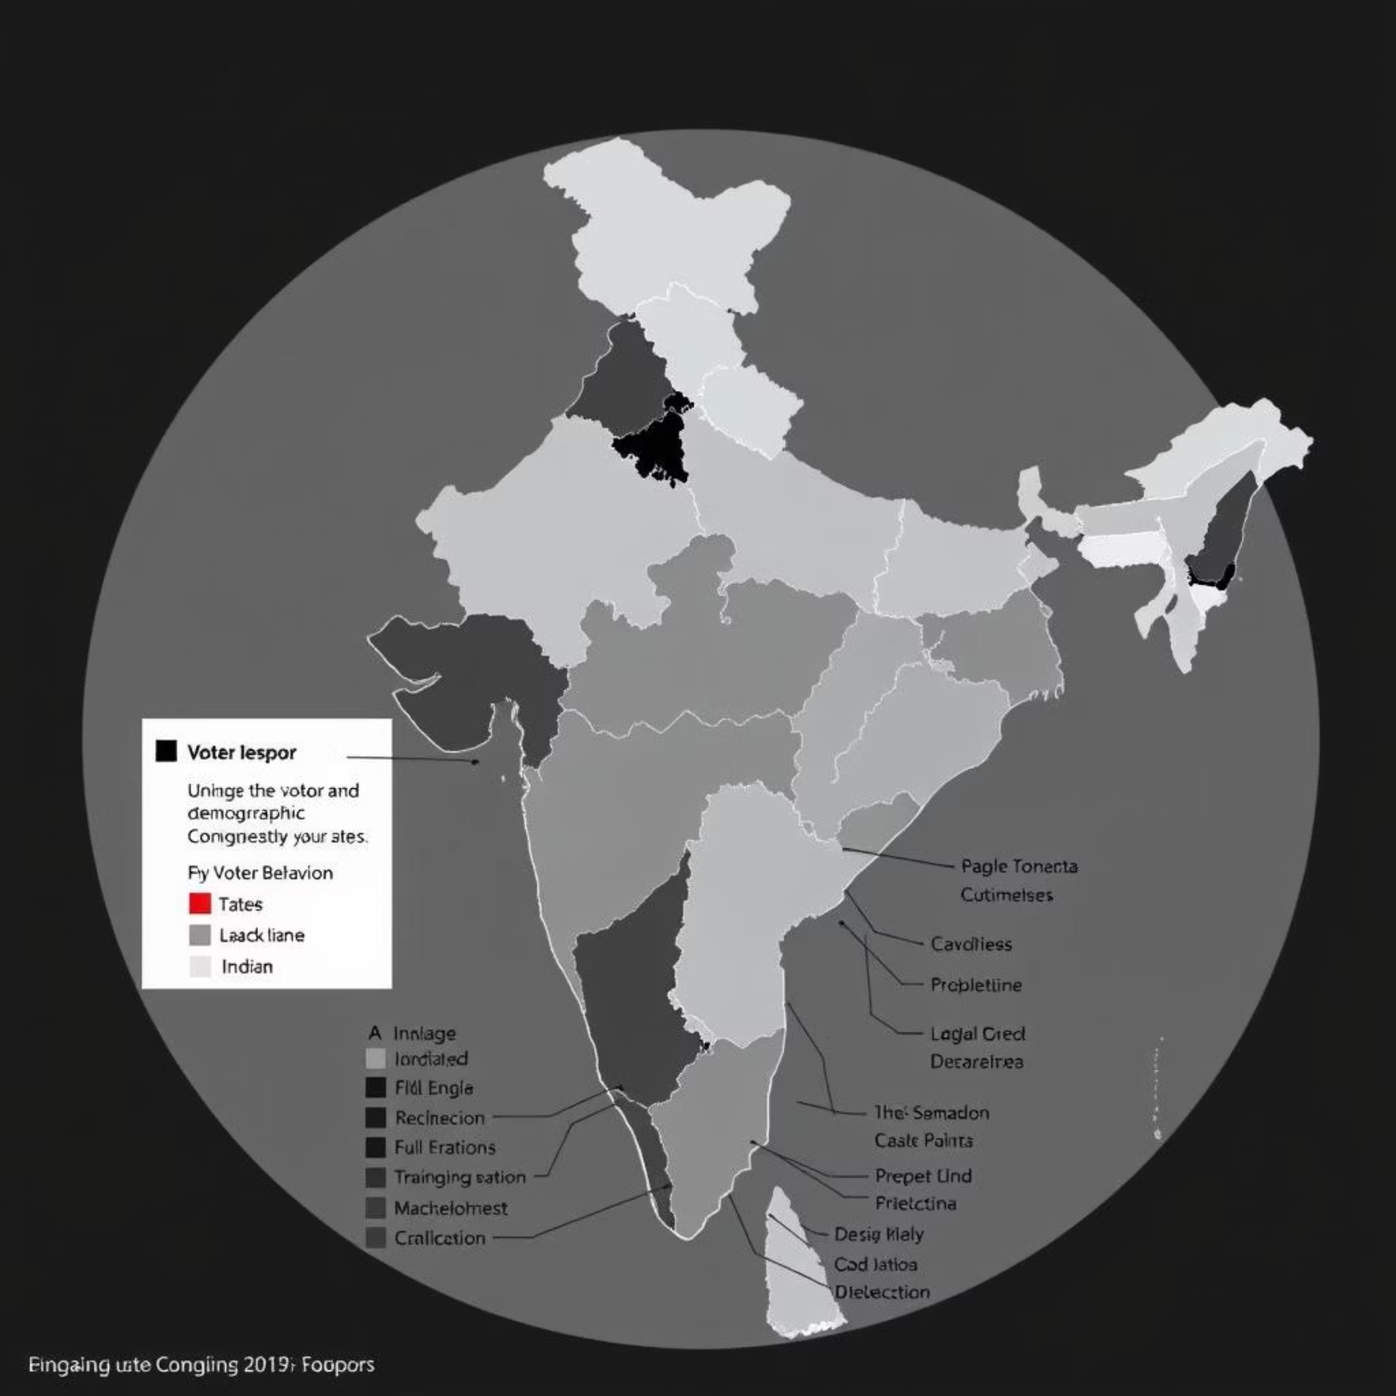
Clustering Results: Uncovering Hidden Electoral Segments
Beyond predicting outcomes, our K-Means clustering analysis provided a data-driven segmentation of constituencies, revealing distinct electoral profiles across India.
Interpreting the Clusters
Our analysis, which utilized optimal K (determined by the Elbow Method and Silhouette Score) as 4, resulted in four primary clusters:
Cluster 1: High Turnout, Rural-Dominant Constituencies Characterized by above-average voter turnout (70-75%) and a strong preference for parties focusing on agricultural policies and local issues. These are typically rural or semi-urban areas with a significant farming population and often show higher collective participation.
Cluster 2: Urban, Educated, and Diverse Constituencies Representing metropolitan and highly urbanized areas with higher literacy rates and diverse populations. Voter turnout is moderate (60-65%), and voters in these clusters tend to be swayed by national issues, economic policies, and social media campaigns. These areas often show a fragmented vote share across multiple national and regional parties.
Cluster 3: Low Turnout, Marginalized Constituencies These clusters exhibited lower voter turnout (50-55%) and often correspond to socio-economically marginalized regions or areas with significant migrant populations. Voting patterns here are often influenced by welfare schemes and promises of basic infrastructure development.
Cluster 4: Swing Constituencies / Highly Contested Regions Characterized by moderate to high turnout (65-70%) and a history of close electoral contests, with no single party consistently dominating. These constituencies are highly sensitive to last-minute campaigning and candidate appeal. They often exhibit a mix of rural and urban characteristics.
These clusters were visualized on a geographical map of India, with each constituency colored according to its assigned cluster. This visual representation provides invaluable strategic insights for political parties, allowing them to tailor their campaign messages and resource allocation more effectively to specific electoral segments.

Slide 9
Key Insights: Decoding the Mandate
Through rigorous data analysis and machine learning, several critical insights emerged, shedding light on the dynamics of Indian elections.
Voter Turnout Complexity
Voter turnout is not uniformly distributed across India. While states with higher literacy and stronger political awareness tend to have higher turnout, several factors such as urban-rural divide, socio-economic conditions, and even the perceived competitiveness of an election significantly influence participation rates. Our analysis showed that strong local candidates and intense campaigning can notably boost turnout in otherwise apathetic regions.
Regionalism Remains Potent
Despite the rise of national parties, regional factors continue to play a dominant role. Chi-square tests confirmed a strong association between geographical region and party preference. This underscores the need for national parties to form strategic alliances or adapt their manifestos to local issues and cultural nuances to gain traction in diverse states.
Predictive Power of Historical Data and Demographics
The high accuracy of our Random Forest model (81%) demonstrates that historical election results, particularly past vote margins and incumbency status, combined with key demographic features (e.g., literacy, urbanization, economic indicators), are highly predictive of future electoral outcomes. This suggests that while dynamic campaign events matter, underlying structural factors have significant long-term influence.
The Swing Voter Phenomenon
Our clustering analysis identified "Swing Constituencies" (Cluster 4), which are highly contested and lack consistent party dominance. These areas are crucial for electoral victories, as they represent the segment of the electorate most likely to shift allegiance. Understanding the specific concerns and demographics of these clusters is vital for targeted campaigning strategies.
Importance of Gender and Age Segments
While direct data was limited, the preliminary insights from available gender and age-wise patterns suggest that women's participation is increasingly influential, especially in states where targeted voter mobilization efforts are strong. The youth demographic (18-35) remains a significant, yet partially untapped, voting bloc, whose preferences can be highly volatile and influenced by digital campaigns.
These insights collectively provide a robust framework for understanding the multi-faceted nature of Indian elections, moving beyond simplistic explanations to a data-driven narrative.

Slide 10

Conclusion and Future Scope: Charting the Path Ahead
This project successfully demonstrated the immense potential of data science in analyzing and predicting electoral outcomes in the Indian context. We have transitioned from raw election data to actionable insights through a rigorous process of preprocessing, exploratory analysis, statistical testing, and machine learning.
Key Takeaways
Future Scope
Robust Predictive Models: Our Random Forest model achieved significant accuracy, proving the viability of using machine learning for electoral forecasting.
The field of electoral data analysis is continuously evolving, and there are several exciting avenues for future research and improvements:
Segmentation for Strategy: K-Means clustering provided valuable segmentation of constituencies, enabling more targeted and effective campaign strategies.
Sentiment Analysis: Integrate social media data and news sentiment analysis to gauge public mood and its impact on voting patterns in real-time.
Data-Driven Insights: We confirmed that historical trends, demographics, and regional factors are powerful determinants of voter behavior and election results.
Time Series Forecasting: Develop advanced time series models to predict shifts in voter sentiment and party popularity over time, especially during long campaign periods.
Value of Visualizations: Charts and maps were instrumental in making complex data patterns intuitive and accessible.
Deep Learning Models: Explore the application of deep learning architectures, such as Recurrent Neural Networks (RNNs) for sequential data (e.g., campaign event impact) or Convolutional Neural Networks (CNNs) for image/text data from political advertisements.
Causal Inference: Beyond correlation, employ causal inference techniques to understand the direct impact of specific policies or campaign events on voter behavior.
Micro-targeting Optimization: Develop models to optimize micro-targeting strategies for political campaigns, identifying the most effective messages for specific voter segments.
Interactive Dashboards: Create interactive web-based dashboards for real-time data exploration, allowing users to delve into the data with customizable filters and visualizations.
We believe that continued investment in data science will further demystify the electoral process, fostering greater transparency and informed decision-making in democracies worldwide.

